Slide 1
Transactions and ACID Properties
Ensuring reliable and consistent data management
Notes:
AI-generated content may be incorrect. ---

Slide 2
Transactions and ACID Properties
Notes:
Introduction to SQL Database Transactions, What is a Database Transaction?, Transaction States, ACID Properties Overview, Atomicity and Consistency, Isolation and Durability, Conclusion

Slide 3
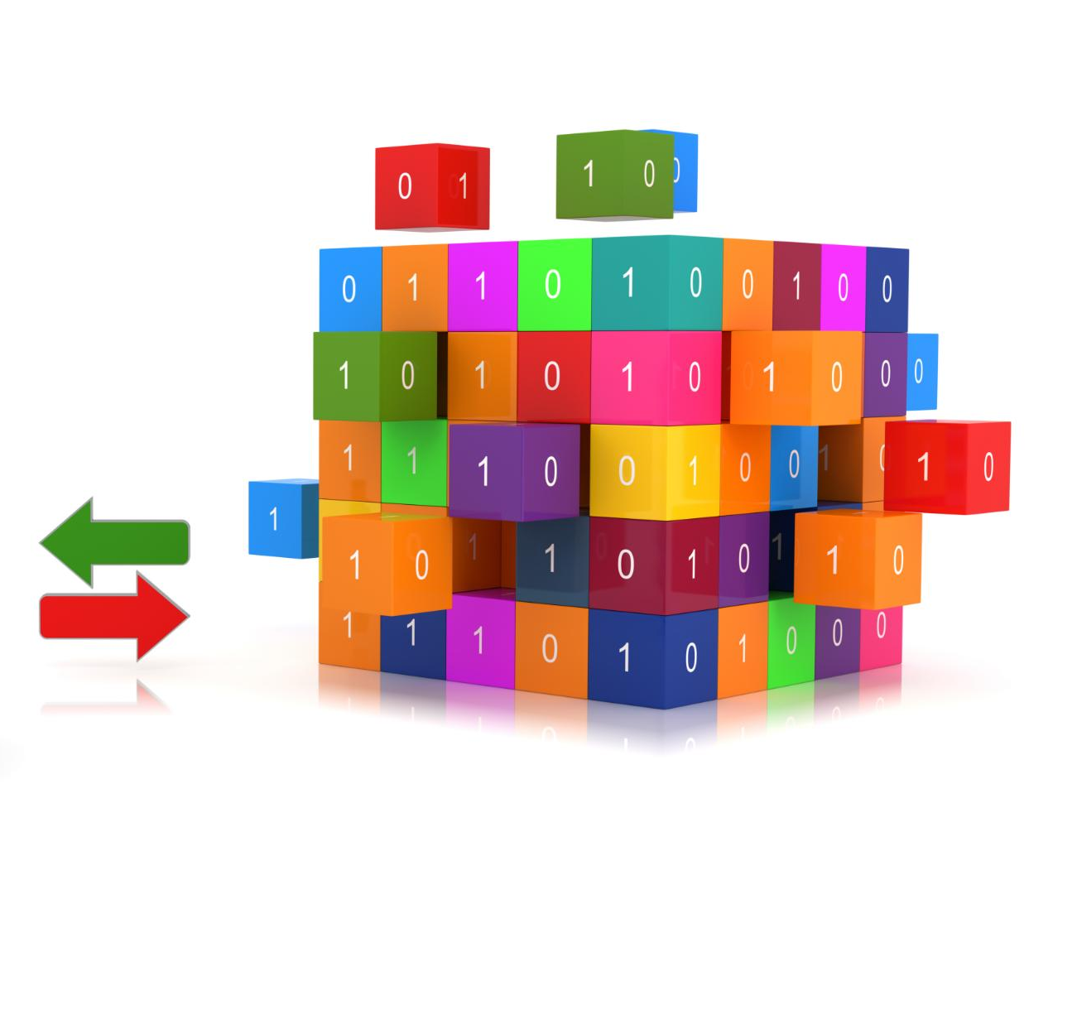
Introduction to Transactions
Role of Transactions
Transactions group SQL operations to ensure all succeed or fail as a single unit, maintaining data integrity.
ACID Properties Overview
ACID properties guarantee safe, predictable transaction behavior in multi-user database environments.
Real-World Application
when we book a movie ticket online, our seat is reserved and payment is processed together. If payment fails, the seat should not be booked.
Notes:
SQL database transactions are a fundamental mechanism used to ensure that data operations are performed reliably and correctly in multi-user and real-world systems. A transaction represents a logical unit of work that may consist of one or more SQL statements such as INSERT, UPDATE, DELETE, or SELECT. These operations are grouped together because they are logically connected and must either all succeed together or fail together. In practical applications like banking systems, shopping platforms, or ticket booking services, a single user action often triggers multiple database changes behind the scenes. Transactions ensure that these changes do not leave the database in an incomplete or incorrect state. The importance of transactions becomes especially clear when failures occur, such as power outages, system crashes, or application errors. Without transactions, partial updates could be saved, leading to inconsistent or corrupted data. This is where ACID properties come into play. ACID—Atomicity, Consistency, Isolation, and Durability—defines a set of rules that guarantee transactions behave in a safe and predictable manner. These properties ensure that even in complex environments with thousands of users accessing the database simultaneously, the data remains accurate and trustworthy. A common real-life example is booking a movie ticket online. When a user selects a seat and makes a payment, both actions must be completed together. If the payment fails, the seat should not be reserved. Transactions combined with ACID properties make sure that such operations behave exactly as users expect, building trust in digital systems.

Slide 4

What is a Database Transaction?
Definition and Purpose
A transaction is a sequence of SQL operations executed as one indivisible unit to maintain data integrity.
Commit and Rollback
Success leads to commit saving changes, failure triggers rollback undoing all changes in the transaction.
Practical Example
Bank transfers require both deduction and addition steps to succeed or fail together to avoid errors.
Broader Applications
Transactions are essential in inventory, order processing, and reservation systems for data consistency.
Notes:
A database transaction is defined as a sequence of one or more SQL operations that are executed as a single, indivisible unit of work. The primary purpose of a transaction is to maintain data integrity and consistency within the database. When a transaction begins, the database treats all included operations as part of one logical task. If every operation completes successfully, the transaction is committed, and the changes are permanently saved. If any operation fails, the entire transaction is rolled back, meaning all changes made during the transaction are undone. This all-or-nothing behavior is crucial in systems where accuracy is critical. A classic example is transferring money between two bank accounts. This process involves at least two operations: deducting money from one account and adding it to another. These steps are logically connected and must be treated as one transaction. If the deduction succeeds but the addition fails, the system would be left in an incorrect state. Transactions prevent such situations by ensuring that both steps succeed together or fail together. Beyond banking, transactions are widely used in inventory management, order processing, and reservation systems. By grouping related operations, transactions simplify application logic and provide a robust way to handle errors and unexpected failures. They act as a safety net that protects the database from ending up in an inconsistent or unreliable state, even when multiple users and applications interact with it simultaneously.

Slide 5

Transaction States
Active State
The transaction is currently executing and processing SQL statements during the active state.
Partially Committed State
All operations are performed but changes are not yet permanently saved in the partially committed state.
Committed State
Changes are permanently written to disk and confirmed in the committed state.
Failed and Aborted States
Transaction fails due to errors and rolls back changes during the aborted state.
Notes:
During its lifecycle, a database transaction passes through several well-defined states that describe its current condition. The first state is Active, where the transaction is currently being executed and SQL statements are being processed. Once the final statement has been executed, the transaction enters the Partially Committed state. At this point, all required operations have been performed, but the changes have not yet been permanently saved to the database. If everything is successful, the transaction moves to the Committed state, where all changes are written to disk and become permanent. However, if an error occurs at any point—such as a system crash, constraint violation, or logical error—the transaction enters the Failed state. From there, it transitions to the Aborted state, where the database performs a rollback to undo any changes made during the transaction. Understanding these states helps database administrators and developers design systems that can recover gracefully from failures. A real-life analogy can be seen in online shopping. When a user adds items to a cart, the transaction is active. Clicking the payment button moves it toward partial commitment. A successful payment leads to commitment, while a payment failure causes the transaction to fail and abort, canceling the order. These states ensure that users do not end up with incomplete orders or incorrect charges.

Slide 6

ACID Properties Overview
Atomicity
Atomicity ensures that each transaction is treated as a single indivisible unit, completing fully or not at all.
Consistency
Consistency maintains database integrity by enforcing rules and constraints during each transaction's execution.
Isolation
Isolation prevents concurrent transactions from interfering, ensuring accuracy in multi-user database environments.
Durability
Durability guarantees that committed transactions persist permanently, even after system failures or crashes.
Notes:
ACID properties form the foundation of reliable transaction processing in relational database systems. The acronym ACID stands for Atomicity, Consistency, Isolation, and Durability. Together, these four principles ensure that database transactions are processed accurately and safely, even in the presence of errors, concurrent access, or system failures. Atomicity guarantees that a transaction is treated as a single unit, meaning it either completes fully or not at all. Consistency ensures that a transaction transforms the database from one valid state to another, always following defined rules and constraints. Isolation makes sure that concurrent transactions do not interfere with each other, preserving correctness in multi-user environments. Durability ensures that once a transaction is committed, its effects are permanent and will survive system crashes or power failures. These properties are especially important in mission-critical applications such as banking systems, airline reservations, and e-commerce platforms. A helpful real-life comparison is a bank’s internal rules for handling money. Every deposit or withdrawal follows strict procedures to ensure that funds are neither lost nor duplicated, customers are not affected by others’ transactions, and records remain accurate even after unexpected issues. ACID properties bring the same level of discipline and reliability to database systems.

Slide 7

Atomicity and Consistency
Atomicity Principle
Atomicity guarantees that transactions are fully completed or fully rolled back to prevent partial data changes.
Consistency Enforcement
Consistency ensures that all database rules and constraints are obeyed, keeping data valid after transactions.
Real-Life Example
ATM transactions demonstrate atomicity and consistency by canceling incomplete withdrawals and maintaining valid balances.
Notes:
Atomicity and Consistency are two closely related ACID properties that focus on correctness and validity of transactions. Atomicity enforces the rule of “all or nothing,” meaning that a transaction must either complete all its operations successfully or have no effect at all. If any single operation within the transaction fails, the database automatically rolls back all changes made so far. This prevents partial updates that could corrupt data. Consistency, on the other hand, ensures that the database always adheres to defined rules, constraints, and business logic. These rules may include primary keys, foreign keys, data type constraints, or application-specific conditions such as non-negative account balances. A transaction that violates any of these rules is not allowed to commit. In real life, consider an ATM transaction. If money is deducted from an account but cash is not dispensed due to a machine error, atomicity ensures the entire transaction is canceled and the money is returned. Consistency ensures that rules like “an account balance cannot be negative” are never violated. Together, these properties protect the database from invalid states and ensure users can trust the system’s behavior at all times.

Slide 8

Isolation and Durability
Transaction Isolation
Isolation prevents interference between concurrent transactions, ensuring data consistency and accuracy.
Ensuring Durability
Durability guarantees that committed transaction changes persist despite system crashes or power failures.
Real-Life Application Examples
Examples include booking system conflicts resolved by isolation and payment confirmations safeguarded by durability.
Notes:
Isolation and Durability address challenges related to concurrency and long-term data reliability. Isolation ensures that multiple transactions executing at the same time do not interfere with each other. Each transaction behaves as if it is the only one accessing the database, even though many may be running concurrently. This prevents problems such as dirty reads, lost updates, and inconsistent data views. Databases achieve isolation using mechanisms like locks and isolation levels. Durability ensures that once a transaction is committed, its changes are permanently recorded and will not be lost, even in the event of a system crash or power failure. This is typically achieved through logging and persistent storage. A real-life example of isolation is two users trying to book the same seat in a theater at the same time; the system must ensure only one booking succeeds. Durability can be seen when a user receives a payment confirmation—once confirmed, the record remains safe even if the server crashes immediately afterward. Together, these properties ensure stable and dependable database behavior.

Slide 9

Conclusion
Role of Database Transactions
Transactions combine related database operations into a single unit, preventing partial updates and ensuring data correctness.
ACID Properties Importance
ACID enforces integrity, consistency, isolation, and durability to protect data in all scenarios.
Real-World Applications
Banking, e-commerce, and reservation systems require ACID compliance to avoid errors like lost money or duplicate bookings.
User Confidence and Scalability
ACID-compliant transactions build user trust by securing data accuracy and enabling systems to handle failures gracefully.
Notes:
Database transactions and ACID properties are essential building blocks for reliable and trustworthy software systems. Transactions ensure that related database operations are grouped into a single logical unit, preventing partial updates and maintaining correctness. ACID properties further strengthen this mechanism by enforcing rules that guarantee integrity, consistency, isolation, and durability of data. In real-world applications such as banking, e-commerce, and reservation systems, these concepts are not optional but mandatory. Without them, systems would frequently encounter errors like lost money, duplicate bookings, or corrupted records. By understanding how transactions work and how ACID properties protect data, developers and database administrators can design systems that scale safely and handle failures gracefully. Ultimately, ACID-compliant transactions provide users with confidence that their data is secure, accurate, and dependable, even in complex and high-traffic environments.

